Slide 1
Immunity by Design:
An Artificial Immune System
Paper: Steven A. Hofmeyr, Stephanie Forrest
Presentation: Joseph Niehaus

Slide 2
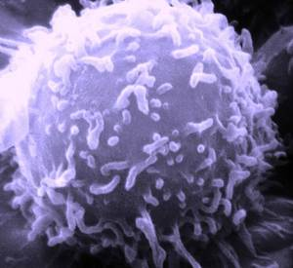
Benefits
Diverse
Distributed
Error Tolerant
Dynamic
Image courtesy of Allergy Details, http://www.allergy-details.com/52-wikipedia-features-immune-system

Slide 3
Architectural Design
Network Security
  Harmful Connections
Adaptive Immune System
  Classifier System
  Host, Detector, Intruder Relationship

Slide 4
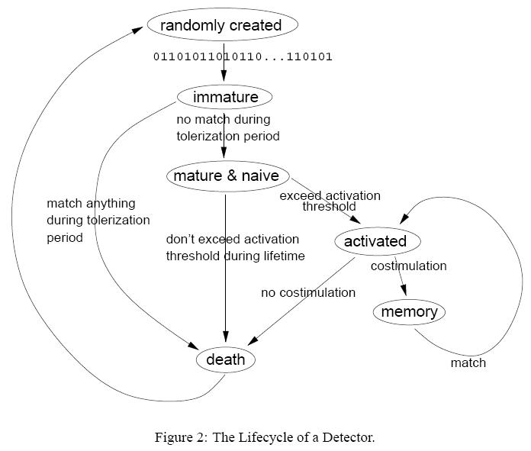
Detectors
Immunity by Design: An Artificial Immune System. Figure 2.

Slide 5
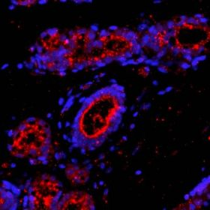
False Positives
Natural Immune System
  High Cycle Rate
  Second Signal
Adaptive Immune System
  Naïve detectors
  Activation Threshold
  Cytokine

